Slide 1

CT4005: Games Production
Lecture 01 - Introduction to the module
John Moss, Dr Will Sayers, University of Gloucestershire

Slide 2
Welcome
Module Staff
John Moss JMoss3@glos.ac.uk
Dr Will Sayers wsayers@glos.ac.uk

Slide 3
Overview
Module Guide
Support
Analyse or Critique
Games Practical
Summary

Slide 4
Moodle (virtual learning environment)
Moodle web site (moodle.glos.ac.uk)
Module guide
Lecture notes, lab sessions
Background reading notes
Tutors
Formative feedback throughout the year
Library
Please make yourself familiar with Moodle as all the requirements you need are there.
Read you assessment guides and make sure you understand them.
Lets have a look at Moodle your VLE

Slide 5
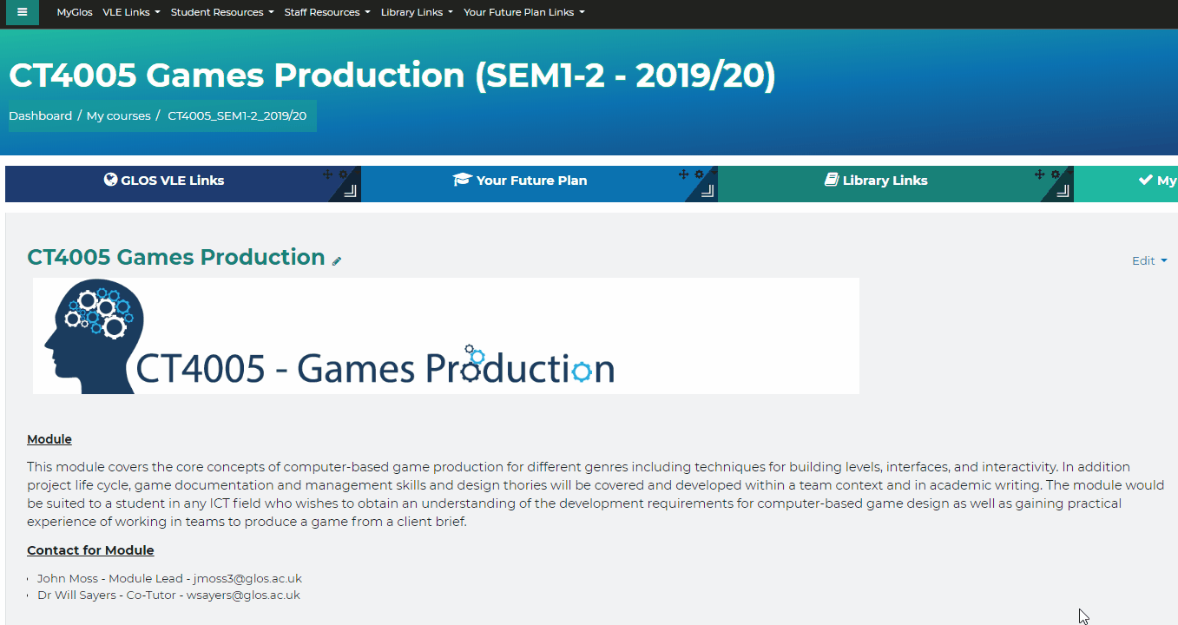
Moodle (virtual learning environment)

Slide 6

Support
Moodle web site
CT4005 – Games Production
Lecture notes and tutorial exercises
Technicians
Contact Liz Graham or ??????????????
Software required available in labs
Adobe Creative Cloud:
Adobe Suite, Unity, Unreal, Substance, 3ds Max
(Note on software if you want to work on version at home and in the labs make sure they are compatible)

Slide 7




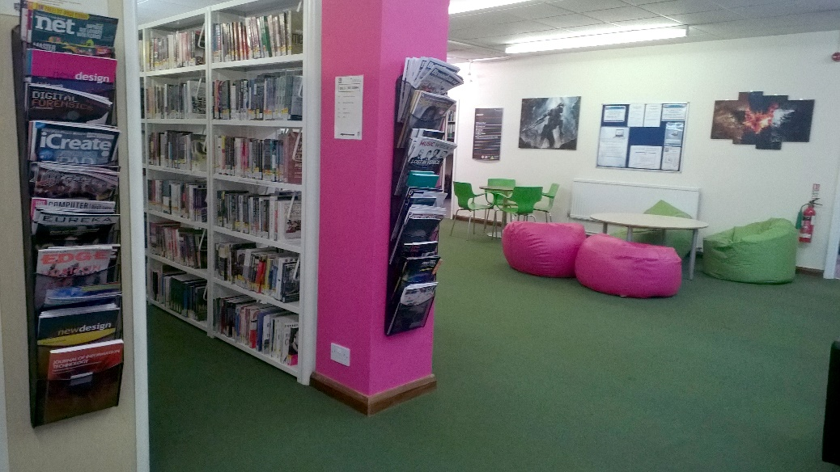

Support
What will you need?
Disk storage
You get 1TB on your university OneDrive account!
Google Drive offers 15GB for free
USB memory disk / drive (32Gb+ recommended) for quick file exchange
Be careful: these don’t last forever
DVD / CD RW very slow & impractical
Backup procedures
Your responsibility: Take this seriously!
Other learning materials?
Books and Online tutorials

Slide 8

Attendance -jisc
Allows students to see their learning activity, set targets, record their own activity amongst other things. It also has a social side, allow students to share their activity and goals with their peers.
Yeh it’s a little big brother - but this allows us monitor your situation and contact you if you need help or support before its too late.
Download study goal for ios or Android
Select UOG University and then sign in with the code provided at the start of the lecture.

Slide 9

Communication - Discord
Problem solve together – your all in the same boat.
Note
Discord is not a replacement for support.
Primary method to communicate to lectures is email.
https://discord.gg/exU4Ez5
https://discord.gg/GKHxnaB

Slide 10
This semesters module Breakdown

Slide 11
Learning Outcomes
understand core game production concepts.
comprehend the technical requirements of a specification for a game product.
appreciate the need for constructing a structured representation of a game during the design phase.
recognise the benefits of working in a multi-disciplinary team when producing games.
participate in a team to produce a prototype game from a client brief.
use background research to establish criteria that evaluates their own work while using Harvard referencing to support said criteria.
Notes:
Understand core game production concepts
We will look at the cycles of games development, Design, Art Roles, Programming
You will gain a grounding within the industry’s design and production principles while developing your creative and teamwork
2D and 3D asset creation, drawing and programming, we will also look at how to make money from your creations, how to manage your business and successfully market your games.
Comprehend the technical requirements of a specification for a game product
you will get a base idea of what is required for the final product and how you plan to achieve those results.
For example if you were working on a 2D or 3D you would use different approach, pipelines, and methods to achieve those goals.
Appreciate the need for constructing a structured representation of a game during the design phase
Using methods used in the games industry, scrum meetings, Concept design, Design principles and theory to correctly represent your games within the design phase.

Slide 12
Module Evaluation – course representatives
EVALUATION FOR 2018/19
The module feedback was largely positive with 80% of students who completed the module taking part.
Students enjoyed the theoretical aspects during lectures to understand what makes Game Play, Game Mechanics, Meaningful play, and players experience attribute to a successful title.
THE RESPONSE FOR THE CURRENT YEAR IS:
Introduce Unity end of Semester one
More practical's delivered in second semester.
Deliver more written types earlier
Notes:
Introduction to games production
Module outlines
Storyboard, concepts,
Even creating prototypes can be time consuming and expensive
Getting it right on the first try is unlikely
Revising existing work can be difficult
Thus the need for some Vision!
Play centric games design
Examining complex processes is never an easy task; thus, approaches that try to divide such complexity into smaller parts that can be more easily understood are necessary. This is called analysis. Analyzing the game design cognition process is a critical part of developing a deeper understanding about how such process works.
Defining the Rules
Rules may be defined as statements and directions that must be followed within a given game in order for it to be played correctly. They are often fixed as "rulesets," created by the game designer and agreed upon by the players. The interactions between rules create the formal system underlying any given game.
Meaningful play
Meaningful play in a game emerges from the relationship between player action and system outcome; it is the process by which a player takes action within the design system of a game and the system responds to the action. The meaningfulness of an action in a game resides in the relationship between action and outcome.
Game Mechanics: Rules of Play
Game mechanics are constructs of rules or methods designed for interaction with the game state, thus providing gameplay.^{[1]} All games use mechanics; however, theories and styles differ as to their ultimate importance to the game. In general, the process and study of game design, or ludology, are efforts to come up with game mechanics that allow for people playing a game to have an engaging, but not necessarily fun, experience.
Introduction to Photoshop and Pixel Art
Show the pipe line from 3D-Photoshop-Unity Used in fluid football.
Introduction to Unity and working with 2D Assets
Full introduction to unity and building a modular level within the Unity Engine.
Programming in Unity, Game Controllers, Multiplayer
local two player coop play to the existing 2D Platformer project which is available on the asset store. We will also add support for controller input, in this case setting up XBox 360 controllers on a Mac.
https://unity3d.com/learn/tutorials/topics/multiplayer-networking/couch-wars-local-multiplayer-basics
https://www.coursera.org/learn/gamedev-platforms/lecture/GA5eG/using-game-controllers
Defining Play, Experience, Pleasure, The Primary Schemas –
introducing the Pleasures of play?
Using sounds and Music
https://unity3d.com/learn/tutorials/topics/audio/sound-effects-scripting
Workshop / Support

Slide 13

Lecture Plan Semester -1
Lecture 01 - Introduction to games production
Lecture 02 - Game Mechanics
Lecture 03 – Gameplay / Rules
Lecture 04 - Meaningful Play
Lecture 05 - Game Play experience
Lecture 06 - Your Future Plan
Lecture 07 – Writing types and feedback
Lecture 08 - Play Centric Games
Lecture 09 – Submission / Unity Intro
#Please note lectures can be subject to change based on feedback and engagement.
Notes:
Introduction to games production
Module outlines
Storyboard, concepts,
Even creating prototypes can be time consuming and expensive
Getting it right on the first try is unlikely
Revising existing work can be difficult
Thus the need for some Vision!
Play centric games design
Examining complex processes is never an easy task; thus, approaches that try to divide such complexity into smaller parts that can be more easily understood are necessary. This is called analysis. Analyzing the game design cognition process is a critical part of developing a deeper understanding about how such process works.
Defining the Rules
Rules may be defined as statements and directions that must be followed within a given game in order for it to be played correctly. They are often fixed as "rulesets," created by the game designer and agreed upon by the players. The interactions between rules create the formal system underlying any given game.
Meaningful play
Meaningful play in a game emerges from the relationship between player action and system outcome; it is the process by which a player takes action within the design system of a game and the system responds to the action. The meaningfulness of an action in a game resides in the relationship between action and outcome.
Game Mechanics: Rules of Play
Game mechanics are constructs of rules or methods designed for interaction with the game state, thus providing gameplay.^{[1]} All games use mechanics; however, theories and styles differ as to their ultimate importance to the game. In general, the process and study of game design, or ludology, are efforts to come up with game mechanics that allow for people playing a game to have an engaging, but not necessarily fun, experience.
Introduction to Photoshop and Pixel Art
Show the pipe line from 3D-Photoshop-Unity Used in fluid football.
Introduction to Unity and working with 2D Assets
Full introduction to unity and building a modular level within the Unity Engine.
Programming in Unity, Game Controllers, Multiplayer
local two player coop play to the existing 2D Platformer project which is available on the asset store. We will also add support for controller input, in this case setting up XBox 360 controllers on a Mac.
https://unity3d.com/learn/tutorials/topics/multiplayer-networking/couch-wars-local-multiplayer-basics
https://www.coursera.org/learn/gamedev-platforms/lecture/GA5eG/using-game-controllers
Defining Play, Experience, Pleasure, The Primary Schemas –
introducing the Pleasures of play?
Using sounds and Music
https://unity3d.com/learn/tutorials/topics/audio/sound-effects-scripting
Workshop / Support

Slide 14
Assignment 1 (30% - individual)
The requirements for assessment 1:
Analysing Game Design (1500 Words)
From the core theories and concepts, you have studied in semester one; select one of the titles below and analyse this from a theoretical perspective. Critically evaluate the game under one of the following criteria:

Slide 15

the following criteria are
1. Gameplay - When you think about a game’s rules, plot, objectives, challenges, and how the player is meant to interact with them, you’re thinking about the gameplay.
2. Game Mechanics - Game mechanics help provide gameplay by providing a construct of methods or rules designed for the player to interact with. Although various theories are out there concerning game mechanics, they are present in pretty much every video game.
3. Meaningful play - Meaningful play in game emerges from the relationship between player action and system outcome; it is the process by which a player takes action within the designed system of a game and the system responds to the action. The meaning of an action in a game resides in the relationship between action and outcome
4. Players experience - Player experience constitutes one of the most significant factors in determining the success rate of games. Games which do not provide enormous user experience usually will not gain intense interest from players. The concept of player experience is normally interchanged with concepts such as fun, flow, fulfillment, enjoyment, engagement, satisfaction, pleasure and playability.

Slide 16
Further your research
Further research on top of your lectures will help you gain more knowledge in which you can use to critically evaluate one of the selected titles. The goal of an analysis is not to formulate an opinion about the game, but rather to outline its characteristics. This process gives you an opportunity to reverse engineer some of a game’s components, so you will have a deeper understanding of a successful title from a design perspective.
You must include a list of references formatted according to the Harvard system to warrant a passing grade. A Harvard referencing tutorial can be found at: https://moodle.glos.ac.uk/moodle/mod/book/view.php?id=343785&chapterid=11634

Slide 17
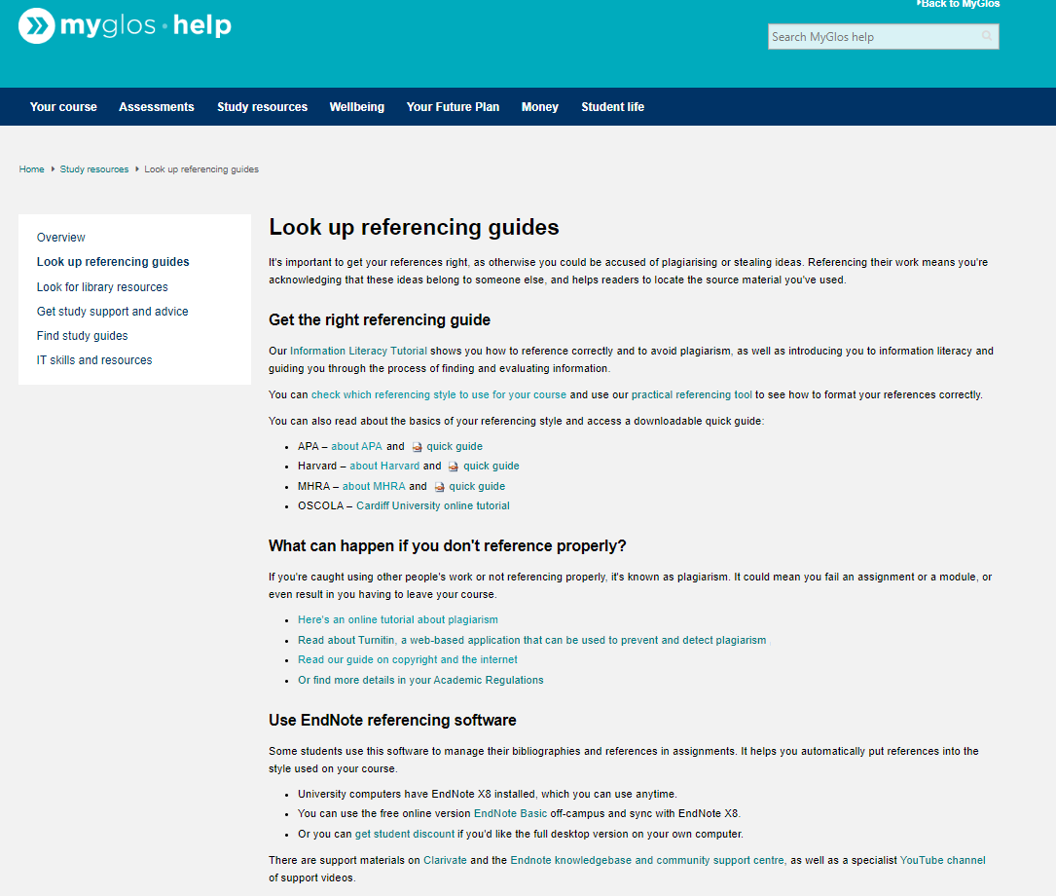
About referencing - what is it, and why do we do it?
The Harvard referencing style is used by the majority of courses at the University of Gloucestershire. However, please confirm with your module tutor which referencing style you should use before commencing.
Why is it important to reference
​It's important to get your references right, as otherwise you could be accused of plagiarising or stealing ideas.
Referencing their work means you're acknowledging that these ideas belong to someone else, and helps readers to locate the source material you've used.

Slide 18
What can happen if you don't reference properly?
If you're caught using other people's work or not referencing properly, it's known as plagiarism. It could mean you fail an assignment or a module, or even result in you having to leave your course.

Slide 19
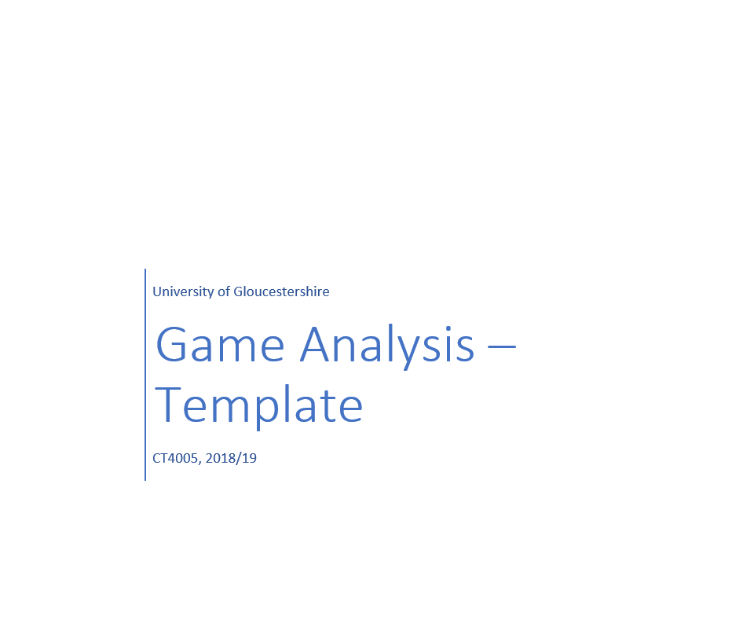
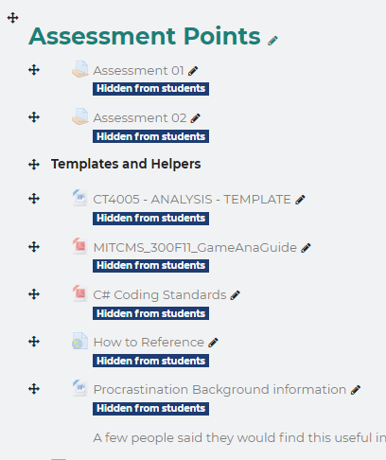
Template (Moodle)

Slide 20
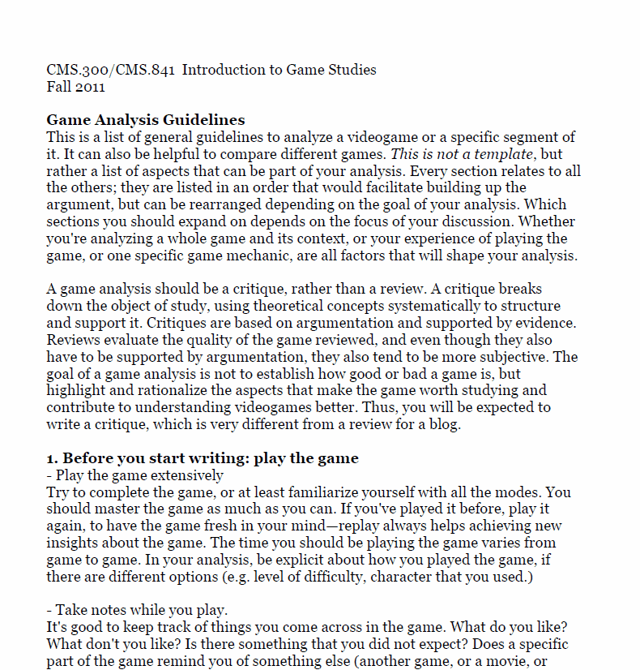
guideline (Moodle)

Slide 21
Why do we need analyse / Think Critical
What's the difference between a review and a critique?
When we Review
This is an holistic approach, (does not analyse each and every segment separately)
Overall either negative or positive feedback with no research
Formal evaluation and is subjective
When we critique
Breaks down the object of study, using theoretical concepts systematically to structure and support it.
Based on argumentation and supported by evidence.
Highlight and rationalize the aspects that make the game worth studying and contribute to understanding videogames better.
Notes:
http://www.open.edu/openlearn/ocw/mod/oucontent/view.php?id=51387&section=4

Slide 22





Selection to Analyse PICK ONE ;)
Selection to Analyse PICK ONE ;)
Portal is a puzzle-platform video game developed and published by Valve Corporation. It was released in a bundle package called The Orange Box for Microsoft Windows, Xbox 360 and PlayStation 3 in 2007
Guide two brothers on an epic fairy tale journey from visionary Swedish film director, Josef Fares and top-tier developer Starbreeze Studios. Control both brothers at once as you experience co-op play in single player mode, like never before.
Horizon Zero Dawn is an action role-playing video game developed by Guerrilla Games and published by Sony Interactive Entertainment. It was released for the PlayStation 4 in early 2017.
Join a young boy and his colossal companion on an incredible journey of trust, friendship and danger in a mysterious land.
Dark Souls III is an action role-playing video game developed by From Software and published by Bandai Namco Entertainment for PlayStation 4, Xbox One, and Microsoft Windows. An entry in the Souls series, Dark Souls III was released in Japan in March 2016 and worldwide in April 2016
Notes:
https://www.youtube.com/watch?v=UAclLDAHWfk
https://www.youtube.com/watch?v=dBmIkEvEBtA

Slide 23
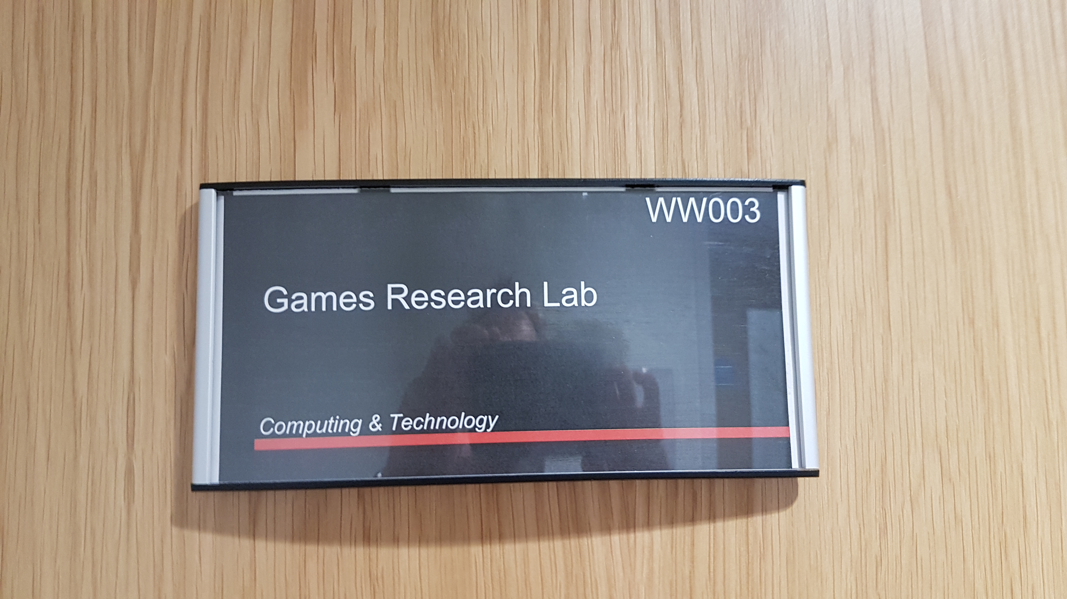
ACESSING THE GAMES
After today a room has been setup for the 8 weeks.
You can access the room by getting the key off ??????? in the research lab. Opposite where are now.
Please note you have no excuses on not playing or having access to the equipment.
To have a better understanding of the chosen title to play and have experience is key and will deepen your understanding.
Playing the game along games reviews, video posts will also broaden your understanding.

Slide 24
Deliverables (Weighted at 30%)
Deliverables (Weighted at 30%)
1500 words with academic support references, minimum 10 references as guidance. Your analysis must be word-processed using a font size of 12 and 1½ line spacing and submitted in Word format. A template will be provided and available from Moodle as Guidance.
11. Special instructions
Submission will be made via Moodle. Early in the semester and through the module you will receive guidance on this procedure.
Note that the independent study tasks during semester 1 will focus on the requirements for this assignment in some detail. This will allow you to develop your theory for the semester and hence attendance is imperative.

Slide 25
Weighted at 30%??
Deliverables (Weighted at 30%)
From you both assessment Semester you must have a mean (average) of 40% to pass the year.
1 st
2nd
Example
The first assessment you get 50% of the weighted 30
Which equates to = 15
Your second assessment you get 50% of 70 you will get 35
This will give you a overall mean of 50%
Your helper ☺

Slide 26
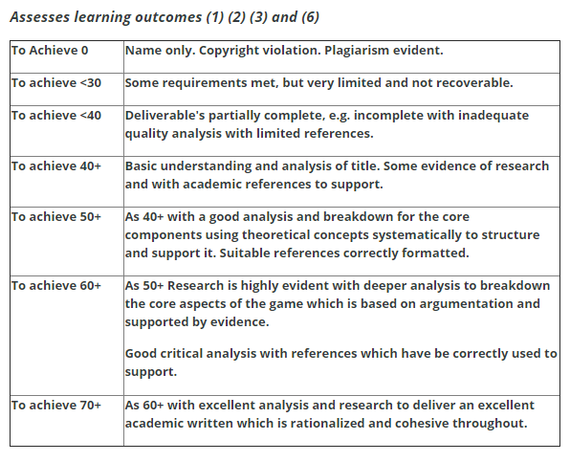
12. Assessment 1 criteria
The grade table on the following page is a guide to the level of practical content required for the assignments.

Slide 27
Extenuating circumstances
EC1 –
Extenuating Circumstances (up to one week – EC1) are based on a signed declaration through self-certification in student records. Three assessment types, Coursework standard; Portfolio; and Dissertation
EC2 –
Help Zones, liaising with Senior Tutors, approve Extenuating Circumstances up to 20 working days. Coursework standard; Portfolio; and Dissertation. Students require supporting evidence from an independent professional.

Slide 28
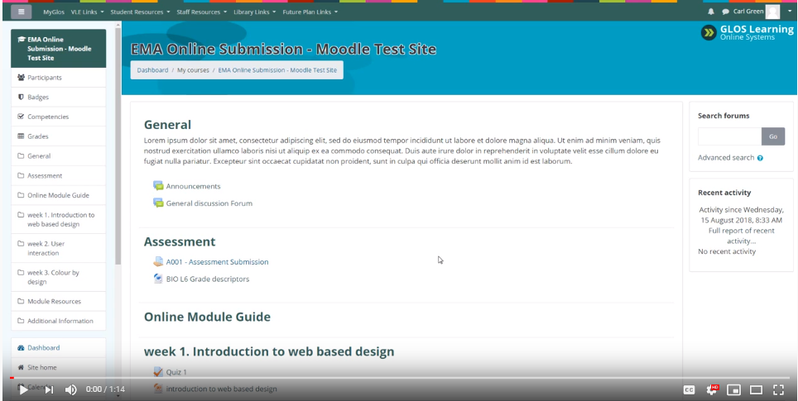
Delivery date for assessment 01
Assessment 01
Due Date - Wednesday, 20 November 2019, 15:00 PM
Submission
Submission will be made under Moodle within Assessment 01.
How to submit
Video walk through
Click to view

Slide 29
Delivery date for assessment 01
Wow that’s early does that mean we then just focus on other modules after our submission date…Right…..?
No!!!!….starting on the 19th November the second assessment starts with the group project.

Slide 30

Approach to Module
Plan your time sensibly
7hrs+ self-study a week
Take notes and ask questions
Quick and easy way to get feedback from tutors
Work incrementally week by week
Start work straight away.
Use the lectures to base your research off.

Slide 31


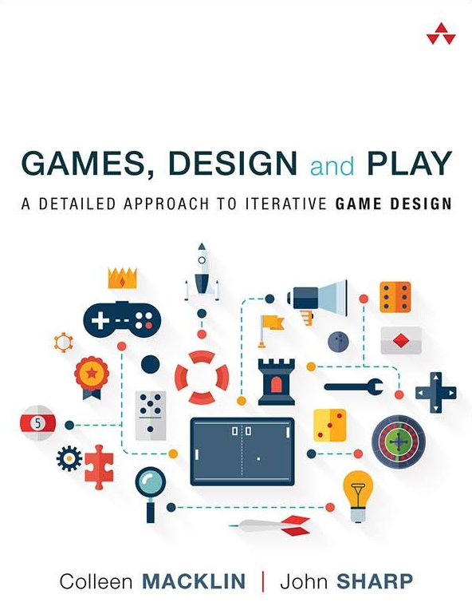
Recommendations / Further your understanding
Its up to you to explore and research
https://glos-on-worldcat org.glos.idm.oclc.org/oclc/982681055
https://glos-on-worldcat-org.glos.idm.oclc.org/oclc/858311849
https://glos-on-worldcat-org.glos.idm.oclc.org/oclc/953686144

Slide 32
Games Design - Where to Start
What we need to consider and understand as a games designer.
This semester will address these aspects of computer games
Analysis
Game play
Rules / Game mechanics
Meaningful play
Players experience

Slide 33
Why is it important to understand
Took more than 35 years for the global games business to grow to $35 billion in 2007
iPhone was introduced. Since then, the games market has added an extra $100 billion in revenues to arrive at this year’s total of $137.9 billion worldwide.
The uptake of smartphones has been a key contributor to the accelerated growth of the games market
The way games are run has changed completely in only 10 years, from both an organizational and a business perspective, regardless of platform.
No other form of entertainment or media gives as much power to the consumer as games.
Games empower people to actively participate, but allow them to enjoy their passion for gaming in ways that suit any mood, interest, lifestyle, location, and budget.

Slide 34
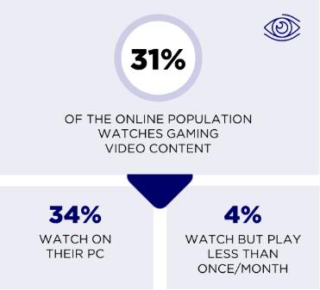


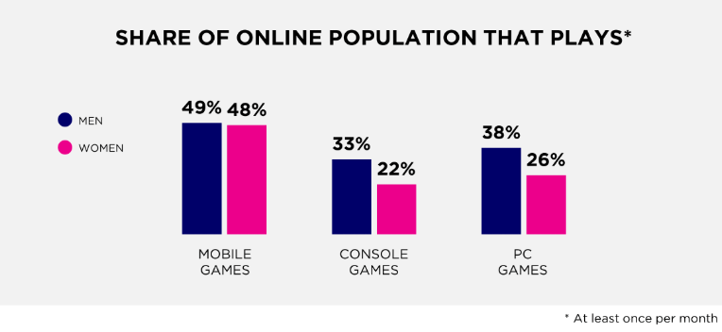
Fast facts
2.3 billion active gamers in the world this year, of which 46%, or 1.1 billion, spend money on games.
The games market will reach $137.9 billion in 2018, with digital revenues accounting for 91% of the market, or $125.3 billion.

Slide 35
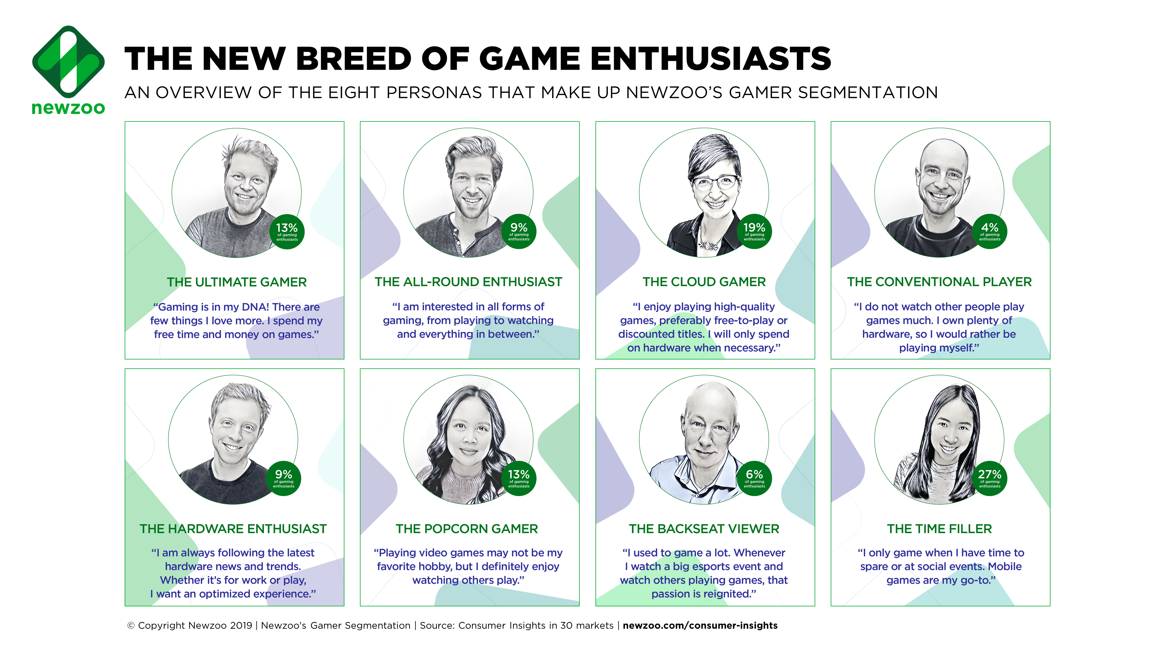
Notes:
This is exactly why we spent the past year pouring our consumer insights experience and games market expertise into developing Newzoo’s Gamer Segmentation™ from the ground up. The result: eight unique personas that encompass all aspects of consumer engagement with games: playing, viewing, and owning.
Newzoo’s Gamer Segmentation features target groups that fly under the radar of traditional segmentation, revolutionizing how these unique groups of individuals are understood and approached. These groups are growing fastest, and—for the most part—have plenty of disposable income to spend. This includes popcorn gamers, who typically do not play many games but love watching game video content/esports
“The last 10 years have seen the games market change dramatically; yet, everybody is still using the same segmentation from a decade ago,” says Peter Warman, CEO of Newzoo. “That doesn’t cut it anymore. All-round entertainment requires an all-round segmentation. This is exactly why we’ve dedicated so much time, expertise, and work to Newzoo’s Gamer Segmentation—a new segmentation for a new breed of diverse game enthusiasts.”

Slide 36

Why do people play computer games?
In 2004, Drs. Cheryl K. Olson and Lawrence Kutner, co-founders and directors of the Center for Mental Health and Media (at Massachusetts General Hospital/Harvard Medical School), began a $1.5 million study funded by the U.S. Department of Justice on the effects of video games on young teenagers. In contrast to previous research, they studied real children and families in real situations.
What they found surprised, encouraged, and sometimes disturbed them.

Slide 37
Why do people play computer games?
An important goal of our research was to understand children’s motivations for game play. We found that almost no research had been done from the perspective of the child game player. After a lot of discussion, our research team came up with 17 possible reasons for play, ranging from “I like to compete and win” to “because there’s nothing else to do” to “it helps me get my anger out.”

Slide 38
Computer Games Users
No surprise, the top reasons included
“I like to ‘mod’ games,”
"I like to learn new things."
"it's some-thing to do when I'm bored.”
"I like to create my own world,"
"I like to compete with other people and win."
“I like the challenge of ﬁguring the game out"

Slide 39
Computer Games Users
To understand this better, they conducted a factor analysis: a statistical method that shows how these reasons for play clustered together. We found rough clusters of four types of game players:
Challenge Gamers
They play mostly because: It’s exciting; it’s fun; I like the challenge of ﬁguring the game out; I like to compete and win
Sociable gamers
They play mostly because: My friends like to play; to make new friends.
Bored gamers
They play mostly because: I’m bored; there’s nothing else to do.
Emotion-driven gamers
They play mostly: To forget my problems; to get my anger out; to feel less lonely.

Slide 40
Computer Games Users
Why worry about the types of players?
Important to understand requirements of target audience when designing games, i.e. consider your users needs
How do you find out what the target audience want?
Competitive survey
Research
Ask them!
Unusual to design for the designer
What you like isn’t necessarily what others like

Slide 41
First of all why do we play games?
Any reason that explains our motivation to do something can be classified as an intrinsic motivator or an extrinsic motivator.
Intrinsic motivation refers to a person’s internal drive to perform an action purely because of the enjoyment they get from it.
For example, an individual doing work for the sole reason that working gives them joy.
Extrinsic motivation refers to a stimulus that originates from external influences, such as money or other types of rewards.
A person taking up a job because they get paid for working.
Understanding what drives our behaviour and motivation as a designer is powerful.
More of this Theory later in the semester.
Notes:
https://medium.com/@SharanShodhan/intrinsic-and-extrinsic-motivation-in-games-a8bbc06aac4

Slide 42

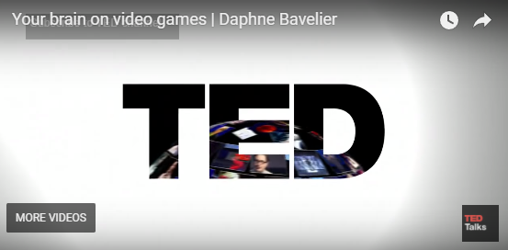

Is it bad for you….?
Playing games can boost your memory….
Notes:
http://msutoday.msu.edu/news/2011/video-game-playing-tied-to-creativity/

Slide 43
Games Design - Tutorial,
1. Can you go to moodle and download the Practical Please.
I would like you all to play these games in pairs and then answer the questions please!
2. You have 45 minutes to play the games.
3. Then we will have discussion and feedback 5 mins.

Slide 44


Self-study
Read through module guide carefully with particular reference to assignment 1
Start working on the assignment today………..
Pick a game and play (the more interest you have on the title the deeper your research)
Read the content provided on Moodle
Write down the aspects of the game you enjoy
Use the analysis template provided to breakdown the game components
Go to the library and research

